Slide 1
Dynamic attractors in
threshold-linear networks
Carina Curto
Dept. of Mathematics
& Center for Neural Engineering
The Pennsylvania State University
ccurto@psu.edu
CNeuro 2020 Summer School
Aug 19-20, 2020

Slide 2
Some motivation: Hopfield & sequences

Slide 3
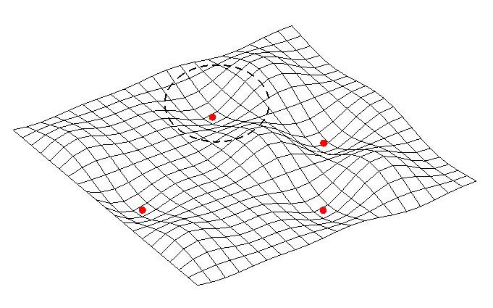
Classical model – Hopfield networks
memory patterns
fixed point attractors
famous Hopfield result: guaranteed convergence
to a fixed point for symmetric interaction matrix

Slide 4
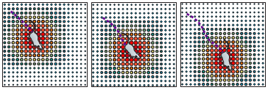
Example: place cell activity in hippocampus
memory patterns
(animal position)
fixed point attractors
(“bump’’ attractors)
McNaughton et. al., Nature Rev. Neurosci. 2006
Tsodyks & Sejnowski 1995,
Samsonovich & McNaughton 1997
Notes:
place fields: $U_1,\ldots, U_n \subset \mathbb{R}^d$

Slide 5
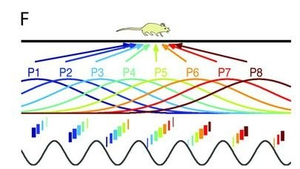
Example: place cell activity in hippocampus
place coding
periodic/dynamic attractors
Individual positions in space correspond to sequences of neural activity
Notes:
place fields: $U_1,\ldots, U_n \subset \mathbb{R}^d$

Slide 6
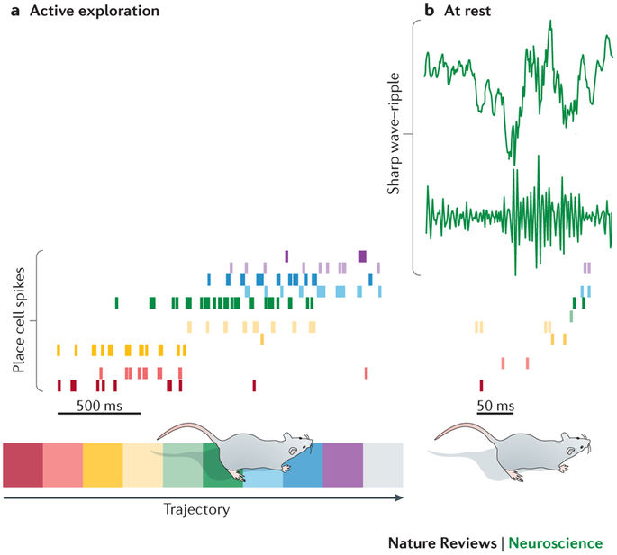
Example: ripple sequences in hippocampus
Colgin (2016) Nature Reviews: Neuroscience
Notes:
Sharp wave ripple events in hippocampus arise in the absence of synaptic input, such as when an animal is asleep. These events appear to play a major role in memory consolidation and the transfer of short-term memory into long-term memory. During these events, there is a burst of neuronal firing and the neurons tend to fire in some type of sequence. In rats trained on a linear track, experimentalists have observed sequences of neurons firing in the order representing that linear path. But there are also many other sequences of neural firing that occur that are not direct correlates of that particular learned sequence.

Slide 7
Example: ripple sequences in hippocampus
Data from Eva Pastalkova’s Lab at Janelia Research Campus
Notes:
Sharp wave ripple events in hippocampus arise in the absence of synaptic input, such as when an animal is asleep. These events appear to play a major role in memory consolidation and the transfer of short-term memory into long-term memory. During these events, there is a burst of neuronal firing and the neurons tend to fire in some type of sequence. In rats trained on a linear track, experimentalists have observed sequences of neurons firing in the order representing that linear path. But there are also many other sequences of neural firing that occur that are not direct correlates of that particular learned sequence.

Slide 8
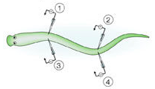
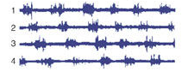
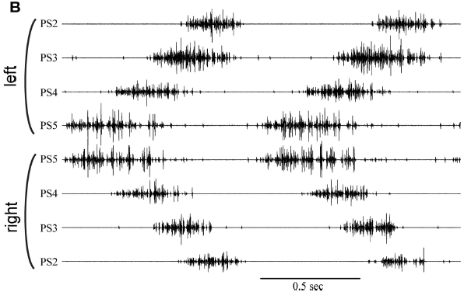
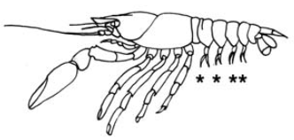
Sequences from CPGs
lamprey
locomotion
Grillner (2003) Nature Reviews: Neuroscience
crayfish
locomotion
Mulloney and Smarandache (2010) Frontiers in Behavioral Neuroscience

Slide 9
What other types of attractors are important for neural computation?
Example: You want to remember Jenny’s phone # 867-5309
projection
of activity
Limit cycles are also useful for modeling central pattern generators (CPGs)
that govern respiration, locomotion, etc.

Slide 10
Recurrent network dynamics (cortex)
Cortical connectivity and sensory coding
K.D. Harris & T.D. Mrsic-Flogel, Nature 2013 (Review)
Diverse coupling of neurons to populations
in sensory cortex. Okun et. al., Nature 2015

Slide 11
Questions: How does a sequence emerge in a recurrent network? How do dynamic attractors relate to network architecture?
Focus: the detailed pattern of connectivity, as reflected in a directed connectivity graph

Slide 12
Threshold-linear networks

Slide 13
Threshold-linear networks (TLNs)
Threshold-linear dynamics
Notes:
Focus on how connectivity shapes dynamics – constant external drive to see how dynamics are shaped by the internal connectivity alone

Slide 14
Threshold-linear networks (TLNs)
Threshold-linear dynamics
multistability
limit cycles
chaos
quasiperiodic attractors
All types of nonlinear behavior arise for effectively inhibitory W
Notes:
Focus on how connectivity shapes dynamics – constant external drive to see how dynamics are shaped by the internal connectivity alone

Slide 15
Example nonlinear dynamics from an inhibitory TLN

Slide 16
Results for TLNs with symmetric W (all about stable fixed points)
X. Xie, R. H. Hahnloser, and H.S. Seung. Selectively grouping neurons in recurrent networks of lateral inhibition. Neural Computation, 2002.
R. H. Hahnloser, H.S. Seung, and J.J. Slotine. Permitted and forbidden sets in symmetric threshold-linear networks. Neural Computation, 2003.
C. Curto, A. Degeratu, and V. Itskov. Flexible memory networks. Bull. Math. Biol., 2012.
C. Curto, A. Degeratu, and V. Itskov. Encoding binary neural codes in networks of threshold-linear neurons. Neural Computation, 2013.
C. Curto and K. Morrison. Pattern completion in threshold-linear networks. Neural Comp., 2016.

Slide 17
Results for TLNs with symmetric W (all about stable fixed points)
X. Xie, R. H. Hahnloser, and H.S. Seung. Selectively grouping neurons in recurrent networks of lateral inhibition. Neural Computation, 2002.
R. H. Hahnloser, H.S. Seung, and J.J. Slotine. Permitted and forbidden sets in symmetric threshold-linear networks. Neural Computation, 2003.
C. Curto, A. Degeratu, and V. Itskov. Flexible memory networks. Bull. Math. Biol., 2012.
C. Curto, A. Degeratu, and V. Itskov. Encoding binary neural codes in networks of threshold-linear neurons. Neural Computation, 2013.
C. Curto and K. Morrison. Pattern completion in threshold-linear networks. Neural Comp., 2016.
Here we just get static attractors (stable fixed points).
We want to study networks that generate rhythms and sequences !

Slide 18
Results for TLNs with NON-symmetric W (having dynamic attractors!)
Here we just get static attractors (stable fixed points).
We want to study networks that generate rhythms and sequences !
Math results for today’s talk on NON-symmetric W:
C. Curto, J. Geneson, K. Morrison. Fixed points of threshold-linear networks.
Neural Computation, 2019, available at https://arxiv.org/abs/1804.00794
C. Curto, C. Langdon, K. Morrison. Robust motifs of threshold-linear networks.
Preprint available at https://arxiv.org/abs/1902.10270

Slide 19
Combinatorial threshold-linear networks (CTLNs)

Slide 20
Combinatorial Threshold-Linear Networks (CTLNs)
graph G
Idea: network of excitatory
and inhibitory cells
TLN dynamics:
Graph G determines the matrix W
parameter constraints:
Notes:
Focus on how connectivity shapes dynamics – constant external drive to see how dynamics are shaped by the internal connectivity alone

Slide 21
Combinatorial Threshold-Linear Networks (CTLNs)
graph G
Idea: network of excitatory
and inhibitory cells
TLN dynamics:
Graph G determines the matrix W
The graph encodes the pattern
of weak and strong inhibition
Think: generalized WTA networks
parameter constraints:
For fixed parameters,
only the graph changes –
isolates the role of connectivity
Notes:
Focus on how connectivity shapes dynamics – constant external drive to see how dynamics are shaped by the internal connectivity alone

Slide 22
Motivating Question:
Given a network, can we predict the attractors that will emerge?
Notes:
One way we might attack this problem is by looking for different motifs within a network that we expect to have a corresponding attractor.

Slide 23
Motivating Question:
Given a network, can we predict the attractors that will emerge?
Why does the sequence 176345 emerge?
Why does neuron 2 drop out?
Notes:
One way we might attack this problem is by looking for different motifs within a network that we expect to have a corresponding attractor.

Slide 24
Graph structure controls dynamics
Thm 1. If G is an oriented graph with no sinks, then the network has no stable fixed points (but bounded activity).

Slide 25
Graph structure controls dynamics
Thm 1. If G is an oriented graph with no sinks, then the network has no stable fixed points (but bounded activity).
Example:
3-cycle
TLN dynamics:
parameter constraints:

Slide 26
4 neural networks with matching degree sequence
A
B
C
D
all graphs have the same
in/out-degree sequence:
(1,2), (1,2), (2,1), (2,1), (2,2)
The four networks are locally identical.

Slide 27
examples of nonlinear network dynamics: limit cycles
A
B
C
D

Slide 28
examples of nonlinear network dynamics: limit cycles
A
B
C
D

Slide 29
examples of nonlinear network dynamics: chaos
A
B
C
D

Slide 30
examples of nonlinear network dynamics: multistability
A
B
C
D

Slide 31

Spontaneous state transitions in large random networks
Model (50 neurons)
Data (66 neurons)
Okun et. al., Nature 2015

Slide 32
Hearing the Rhythms - Network Songs !
created by Carina Curto & Katherine Morrison
January 2017 version
Input: a simple directed graph G satisfying two rules:
G is an oriented graph (no bi-directional connections), and
every node (neuron) of G has at least one out-going edge.
Process: Use the graph to create a neural network with threshold-linear dynamics (next slide). Next, choose an initial condition and compute the solution to the network equations. The solution is a set of firing rates, one per neuron, as a function of time.
Finally, associate a piano key to each neuron, and use the neuron’s firing rate to modulate the amplitude of the key’s frequency. Superimpose the amplitude-modulated frequencies for all neurons to obtain a single acoustic signal.
Output: the resulting acoustic signal is the network’s song !

Slide 33

song 1: penta
The sequence of notes and the rhythm are emergent properties of the
network dynamics.

Slide 34
song 1: penta
song 2: skipping
The only difference between these networks is the pattern of connections.

Slide 35
song 3: whistle
Can you hear how this one takes longer to settle into the repeating pattern?

Slide 36
song 4: arhythmia
Does the song for this network ever perfectly repeat?

Slide 37
Relationship between (unstable) fixed points and dynamic attractors

Slide 38
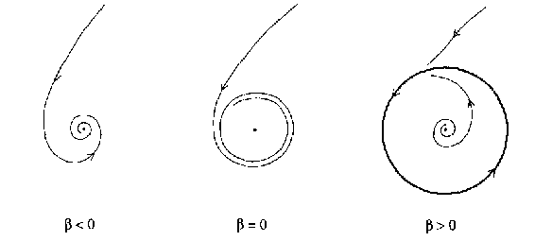
a stable fixed point becomes unstable in a Hopf bifurcation, creating a limit cycle
stable focus
limit cycle

Slide 39
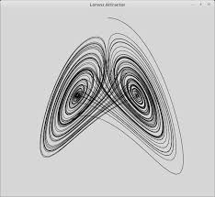
unstable fixed points in chaotic attractors
A
B
C
D
Lorenz attractor
baby chaos: 4 attractors

Slide 40
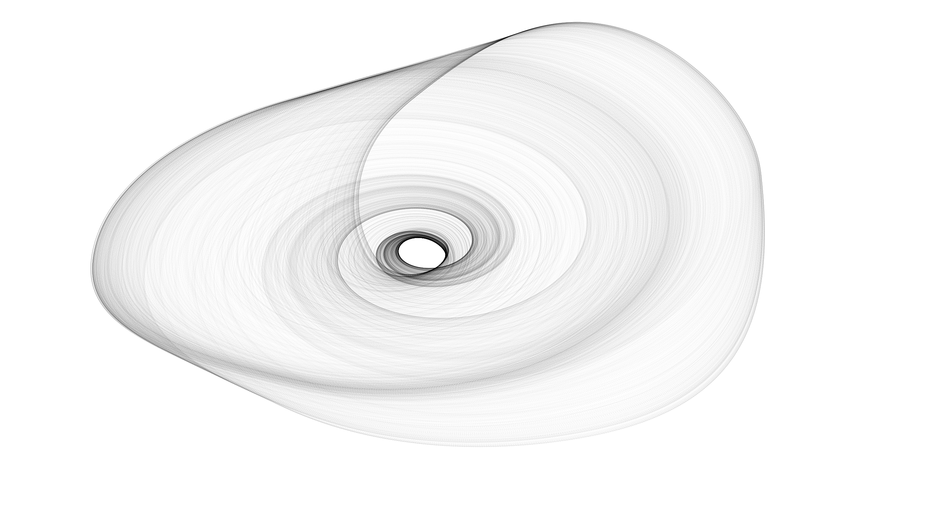
unstable fixed points in chaotic attractors
A
B
C
D
baby chaos attractor
Picture created by Rainer Engelken

Slide 41
Back to the 3-cycle, how does the limit cycle emerge?
2

Slide 42
Back to the 3-cycle, how does the limit cycle emerge?
2

Slide 43
Embedding of motif matters
Example:
3-cycle

Slide 44
Embedding of motif matters
Example:
3-cycle
Is this a general principle, that added sources drop out of the dynamics?

Slide 45
When do 3-cycles produce attractors in larger networks?
2
A
3-cycles
235, 145
limit cycles
235 only

Slide 46
TLNs as a patchwork of linear systems
Different linear system
of ODEs for each
Notes:
Focus on how connectivity shapes dynamics – constant external drive to see how dynamics are shaped by the internal connectivity alone

Slide 47
Patchwork of linear systems for the 3-cycle yields a limit cycle
2

Slide 48
Limit cycle emerges from the unstable fixed point of 3-cycle

Slide 49
When do 3-cycles produce attractors in larger networks?
A
3-cycles
235, 145
limit cycles
235 only
B
3-cycles
125, 253, 145
limit cycles
125, 253 only

Slide 50
When do 3-cycles produce attractors in larger networks?
A
3-cycles
235, 145
limit cycles
235 only
B
3-cycles
125, 253, 145
limit cycles
125, 253 only
How does embedding affect each 3-cycle’s attractor?

Slide 51
Effect of embedding on the 3-cycle attractor
2
When the 3-cycle attractor survives to the full network,
it is affected by addition of peripheral neurons

Slide 52
Effect of embedding on the 3-cycle attractor
2
When the 3-cycle attractor survives to the full network,
it is affected by addition of peripheral neurons
But when does the attractor survive?
Notes:
To understand what shapes the survival of an attractor when it’s embedded, it is essential to understand the mechanics of how the attractor emerges.

Slide 53
Surviving (unstable) fixed points determine which 3-cycles
of the graph give rise to limit cycles in the dynamics.
A
3-cycles
235, 145
3-cycle fixed pts
235 only
B
3-cycles
125, 253, 145
3-cycle fixed pts
125, 253 only

Slide 54
Rule of Thumb: Fixed points and attractors
A core motif is a subgraph with a unique fixed point
that has full support, i.e. for all

Slide 55
Every core motif has an associated attractor if and only if its fixed point survives in the full network.
Rule of Thumb: Fixed points and attractors
A core motif is a subgraph with a unique fixed point
that has full support, i.e. for all
Rule of Thumb:
Moreover the attractor is accessible from an initial condition that is a perturbation of the fixed point.

Slide 56
Testing the Rule of Thumb

Slide 57
Testing the Rule of Thumb
Complete analysis of attractors of the 160 non-isomorphic graphs on neurons that are oriented with no sinks.

Slide 58
Testing the Rule of Thumb
Complete analysis of attractors of the 160 non-isomorphic graphs on neurons that are oriented with no sinks.
Rule of thumb correctly predicts the set of attractors corresponding to core motifs for 154 of the 160 graphs for standard parameter values. If we vary parameter values, then the rule of thumb holds for all 160 graphs.

Slide 59
Additional n=5 core motifs

Slide 60
Example (non-oriented) core motifs

Slide 61
Graph rules for fixed points of CTLNs:
finding core motifs

Slide 62
Graph rules for fixed points of CTLNs:
finding core motifs
C. Curto, J. Geneson, K. Morrison. Fixed points of threshold-linear networks.
Neural Comp., 2018 (in press), available at https://arxiv.org/abs/1804.00794
Main ideas for the proofs:
fixed points ←→ signs coming from various Cramer’s rule determinants,
figuring out relationships between various relevant determinants,
constraints from the graphs on determinants, and thus on fixed points.

Slide 63
A simple graph rule for cycles and other
uniform in-degree graphs
If G has uniform in-degree, it supports a fixed point
If a subgraph is a fixed point support, this fixed point may or may not survive to the full graph!

Slide 64
A simple graph rule for cycles and other
uniform in-degree graphs
If G has uniform in-degree, it supports a fixed point
If a subgraph is a fixed point support, this fixed point may or may not survive to the full graph!
Theorem. Let G has uniform in-degree d.
Fixed point survives no node outside G receives d+1 (or more) edges from G

Slide 65
Which 3-cycles have surviving fixed points?
Corollary. Let G be a cycle.
Fixed point survives no node outside G receives 2 (or more) edges from G
A
3-cycles
235, 145
3-cycle fixed pts
235 only
B
3-cycles
125, 253, 145
3-cycle fixed pts
125, 253 only

Slide 66
Graph rules for permitted and forbidden motifs

Slide 67
Small core motifs
Graph rules enabled us to prove there are exactly 9 core motifs up to size 4, and these are all parameter independent

Slide 68
Small core motifs
Graph rules enabled us to prove there are exactly 9 core motifs up to size 4, and these are all parameter independent
We can also prove there are 37 parameter-independent core motifs of size 5 (and 8 that depend on parameters)

Slide 69
Testing the Rule of Thumb on ALL n=5 graphs
Complete analysis of the attractors of all 9608 non-isomorphic directed graphs on 5 neurons (for epsilon = .51 and delta =1.76).
Rule of thumb correctly predicts the set of attractors as coming from (surviving) core motifs for 9586 out of the 9608 graphs.
There are 1053 graphs that have potential for dynamic attractors (contain an unstable core motif or no core motifs). From these 1053 graphs, we observe 1130 dynamic attractors.
Of these 1130 dynamic attractors, approximately 40 are qualitatively distinct.
Note: There are 19 graphs that have a core motif with no corresponding attractor, and 3 graphs that have *no* core motifs in this parameter regime.

Slide 70
Pause to check out code
Matlab code for n=5 classification of CTLN attractors:
https://github.com/ccurto/n5-graphs-package
Matlab code for book chapter:
https://github.com/nebneuron/CTLN-bookchapter

